Slide 1
Cryptography
Lecture 9
Vahid Amin-Ghafari
Vahidaming@ustc.edu.cn

Slide 2
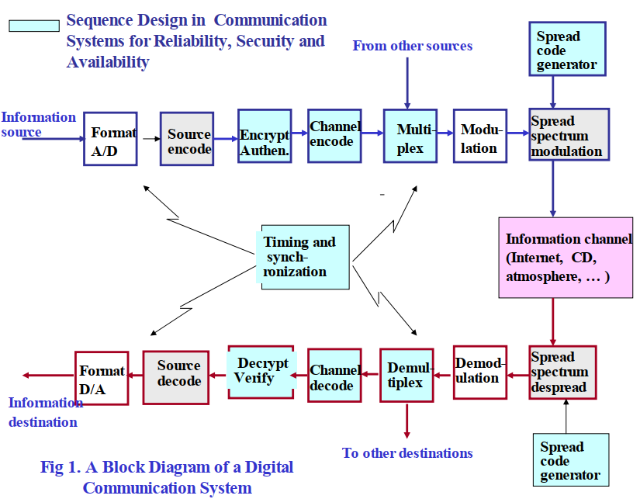
A Block Diagram of a Digital Communication System

Slide 3
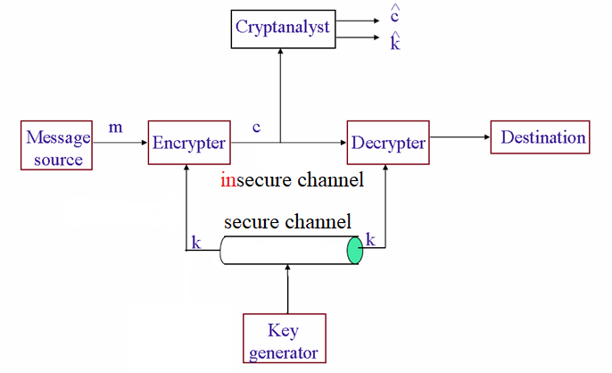
Private Key Encryption (review)

Slide 4
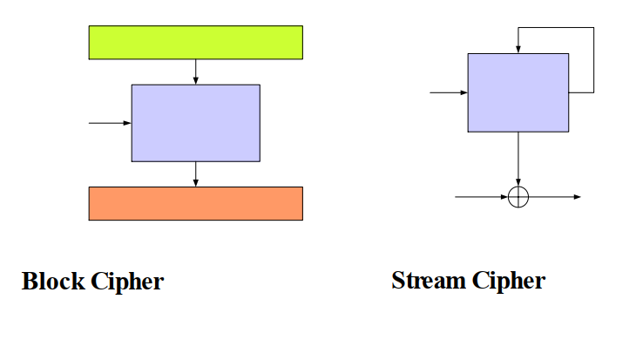
Symmetric Key Encryption

Slide 5
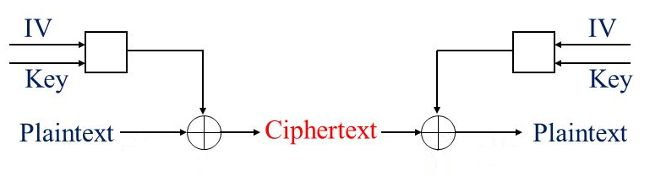
Stream ciphers
Stream ciphers are important class of symmetric-key ciphers.
They encrypt/decrypt with high speed and require low resource.
They prevent to propagate errors in the other positions of cipher if in the channel encrypted message be corrupted.
Thus, it is best candidate to protect the privacy in cellphones and low-level environments such as RFID or wireless sensor networks. They contain internal states that vary with time and generate pseudo-random output stream (keystream). The output stream is then bitwise XORed with the message to encrypt/decrypt.

Slide 6
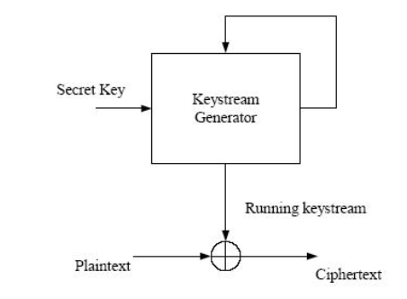
General Model of a Stream Cipher

Slide 7
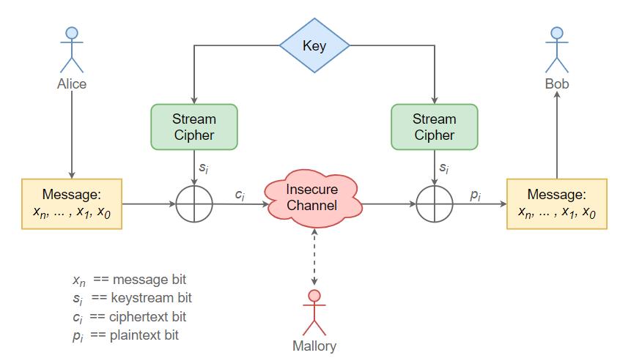
How it is work?

Slide 8
Example of Stream Encryption
Key
IV
Keystream
⊕
Plaintext
=
Ciphertext

Slide 9
Example of Stream Decryption
Key
IV
Keystream
⊕
Ciphertext
=
Plaintext

Slide 10
Stream Ciphers
Shannon in his milestone work showed that one-time-pad is unconditional secure – leads to a fantasy to search for secure key stream generators. Problem: hard to resynchronization between transmitters and receivers
Stream ciphers suffered from: the same key used twice gives the same keystream
Hardware: High speed and low complexity (ideal for constrained platforms: PDA’s, sensors, etc.)
Software: High speed

Slide 11
Efforts for Standardization of Steam Ciphers
In 2001-2004, a new initiative known as the New European Schemes for Signatures, Integrity, and Encryption (NESSIE) announced its call for cryptographic primitives including stream ciphers.
The latter could become new encryption algorithms for the 3G and 4G systems.
However, it did not make any recommendations for the submitted candidates.
ECRYPT is a Network of Excellence within the Information Societies Technology (IST) Program of the European Commission. The ECRYPT Stream Cipher Project is a multi-year (2004-2008) project to identify new stream ciphers that might become suitable for widespread adoption. There are 34 submissions.

Slide 12
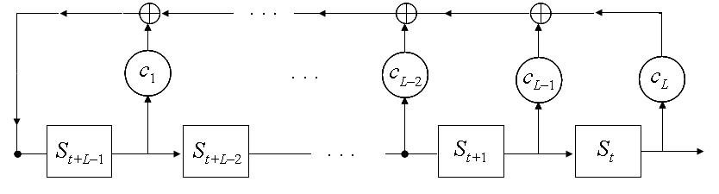
linear feedback shift register (LFSR)
One of the best-known building blocks for stream cipher

Slide 13
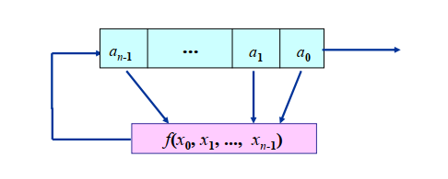
Linear Feedback Shift Registers (LFSR)

Slide 14


Three Components
n-stage shift register: n 2-state storage units
Initial state (${\text{a}}_{0}$, $a_{1}$, ..., ${\text{a}}_{\text{n}\text{−}\text{1}}$)
Feedback function: f(${\text{x}}_{\text{0}}$, ..., ${\text{x}}_{n}$) is a Boolean function in $n$ variables:

Slide 15


Linear Feedback Shift Registers (LFSR)
For example, the next state is:

Slide 16

Linear Feedback Shift Registers (LFSR)
So, we have a sequence
where the recursive relation is given by

Slide 17
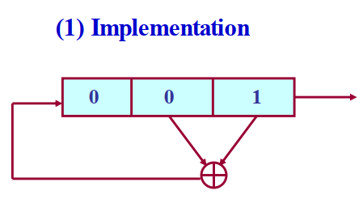
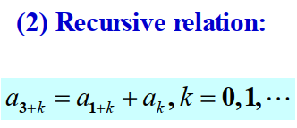
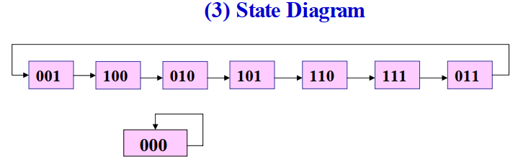

A 3-stage LFSR with a feedback function
f (${\text{x}}_{0}$, ${\text{x}}_{1}$, ${\text{x}}_{2}$ ) = ${\text{x}}_{0}$ + ${\text{x}}_{1}$

Slide 18
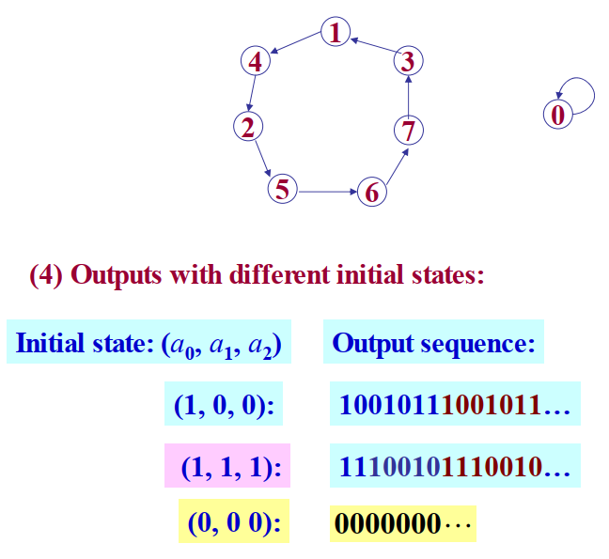

Slide 19
Stream ciphers
Produced sequence of LFSR has good randomness properties and also large period.
Output sequence of LFSR is linear that is not acceptable as a random stream in cryptosystem.
Therefore non-linear filter must be used in the stream ciphers.
There are 3 ways for using of LFSR in the Stream cipher.
Notes:
(because it is completely predictable).

Slide 20
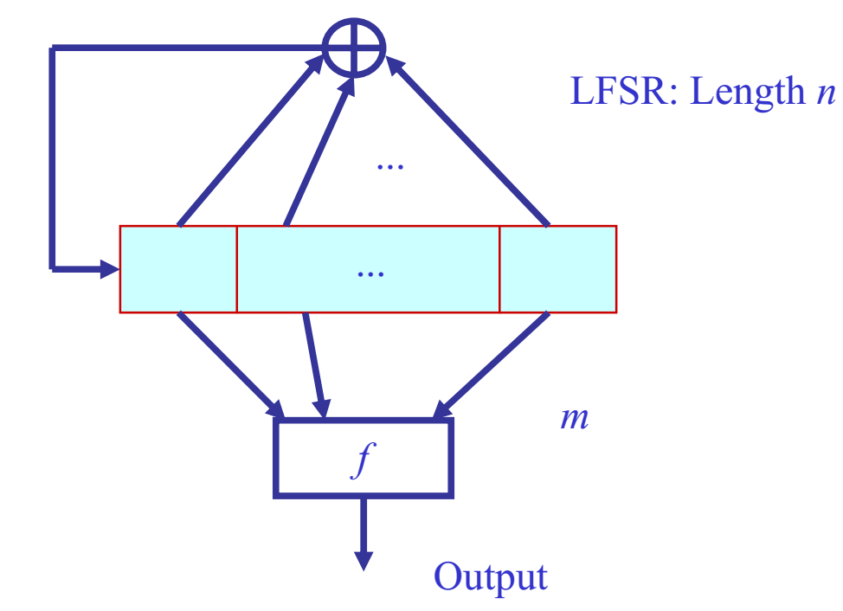
Stream ciphers
Filter generator

Slide 21
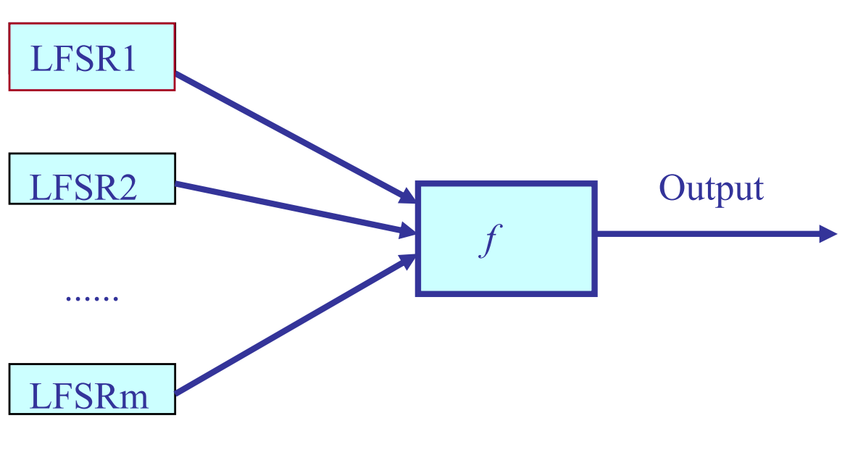
Stream ciphers
Non-linear combining functions

Slide 22
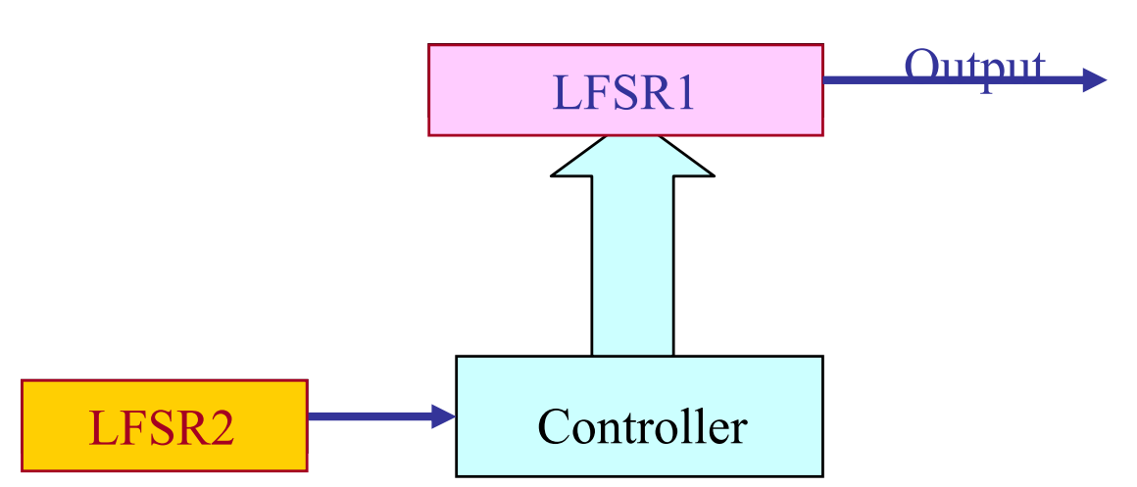
Stream ciphers
Clock-controlled generators

Slide 23
Stream ciphers
The idea is that the linearity section would guarantee good statistical properties and guarantee about period, while the nonlinearity part would protect against attacks that can be mounted against a linear cryptosystem.
In 2004 a project was born, called eSTREAM.
There were two profiles that every submission must fall into.

Slide 24
eSTREAM project
PROFILE 1. Stream ciphers for software applications with high throughput requirements.
PROFILE 2. Stream ciphers for hardware applications with restricted resources such as limited storage, gate count, or power consumption.
Three Stream ciphers have been introduced in the hardware profile of portfolio of eSTREAM project that they use FSR component.
They are Trivium and MICKEY 2.0 and Grain v1.

Slide 25
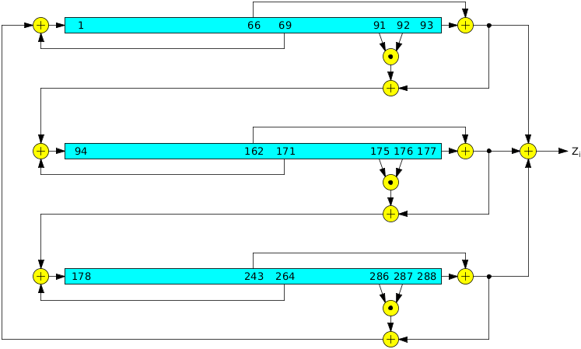
Trivium Stream cipher

Slide 26
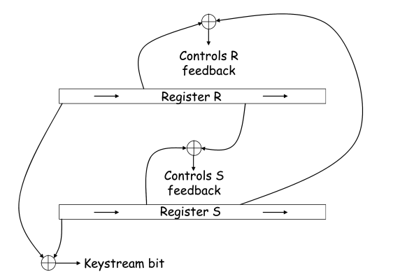
MICKEY 2.0 Stream cipher

Slide 27
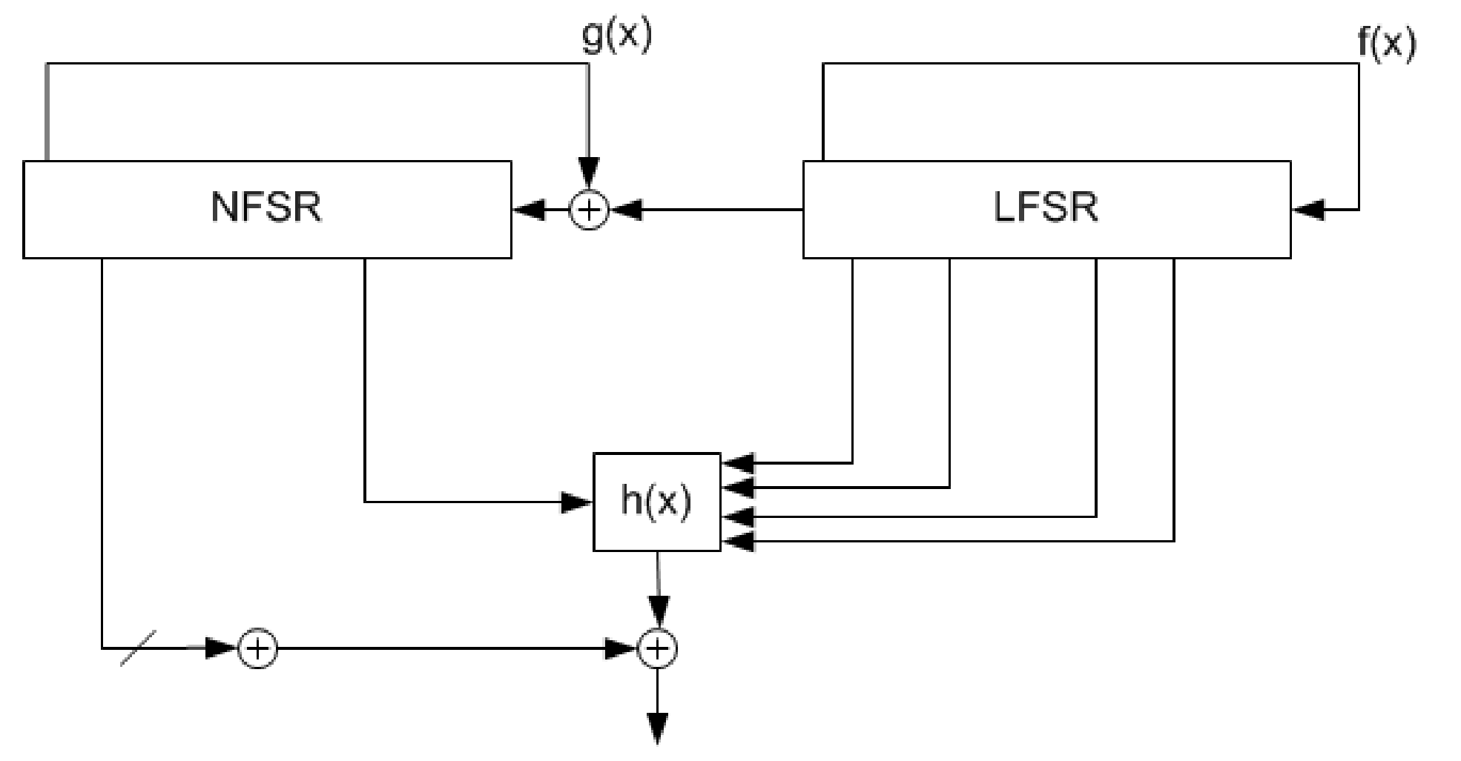
Grain v1 Stream cipher

Slide 28
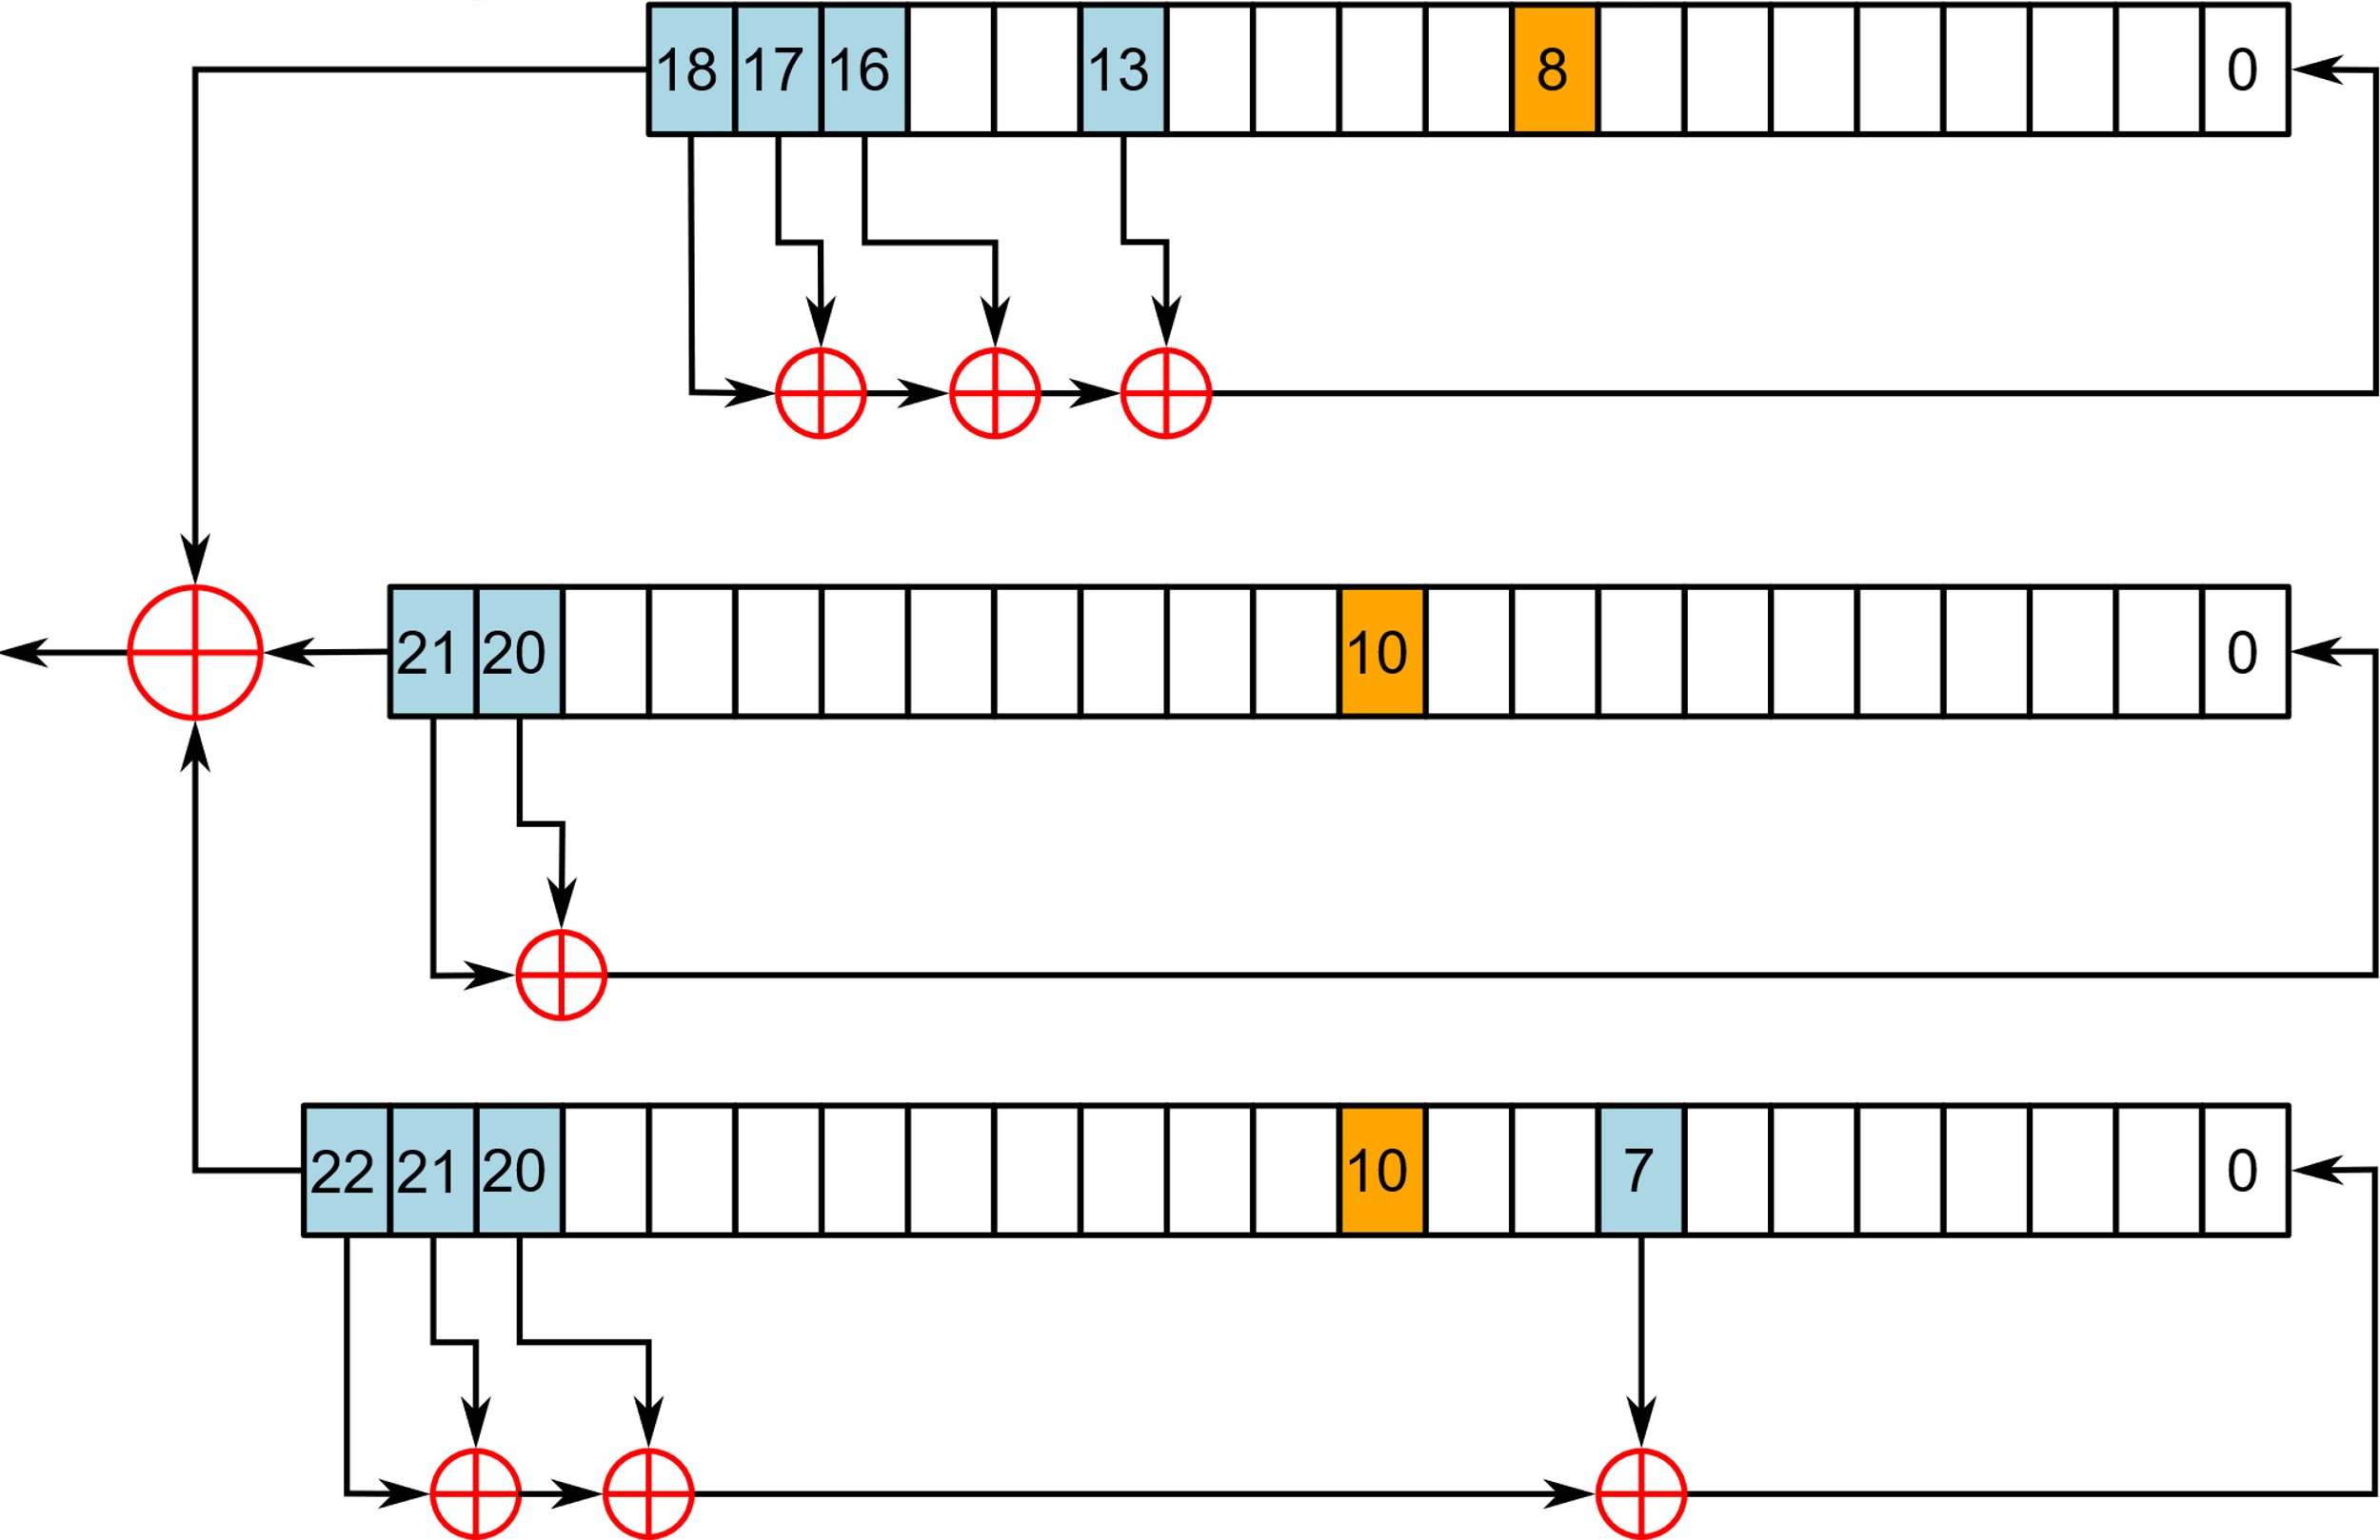
A5/1

Slide 29
A5/1
A5/1 is used in Europe and the United States.
A5/2 was a deliberate weakening of the algorithm for certain export regions
The A5/1 stream cipher uses three LFSRs. A register is clocked if its clocking bit (orange) agrees with the clocking bit of one or both of the other two registers.

Slide 30

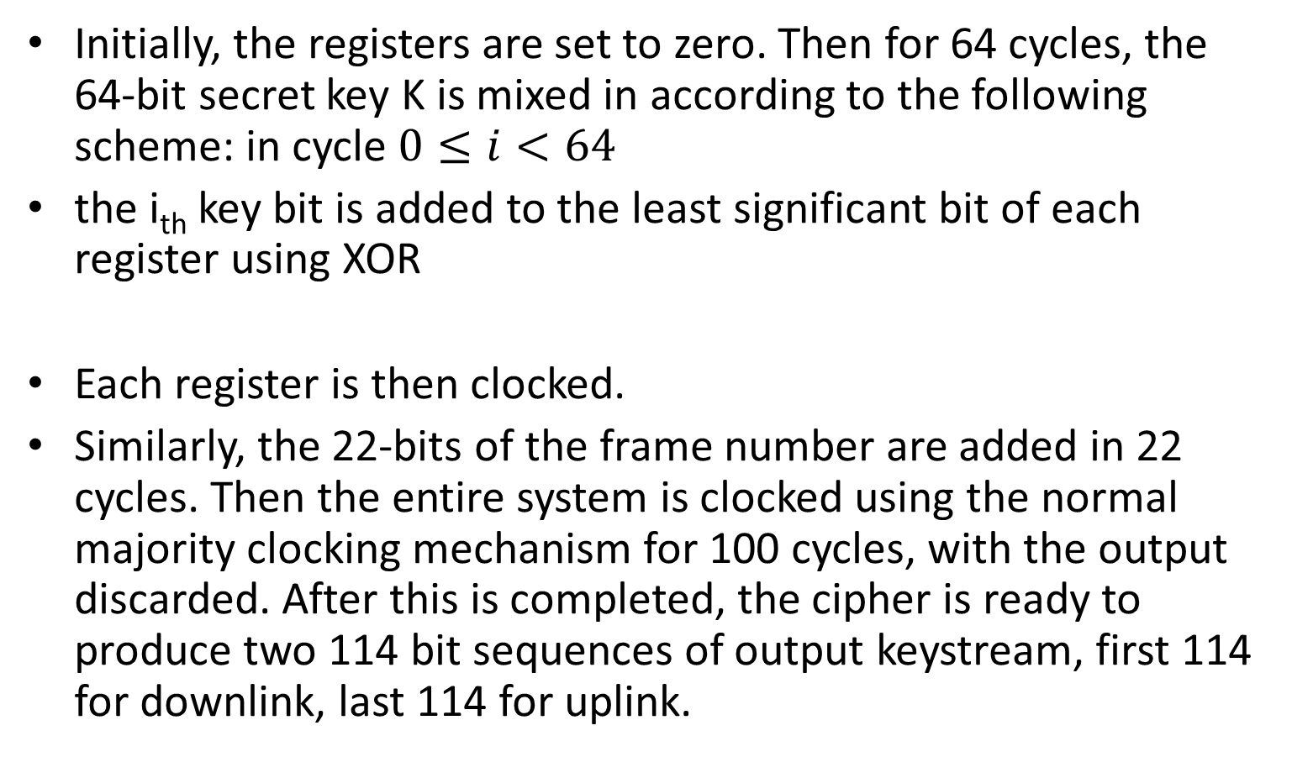
Initialization of A5/1
Initially, the registers are set to zero. Then for 64 cycles, the 64-bit secret key K is mixed in according to the following scheme: in cycle $0≤i<64$
the i_{th} key bit is added to the least significant bit of each register using XOR
Each register is then clocked.
Similarly, the 22-bits of the frame number are added in 22 cycles. Then the entire system is clocked using the normal majority clocking mechanism for 100 cycles, with the output discarded. After this is completed, the cipher is ready to produce two 114 bit sequences of output keystream, first 114 for downlink, last 114 for uplink.

Slide 31
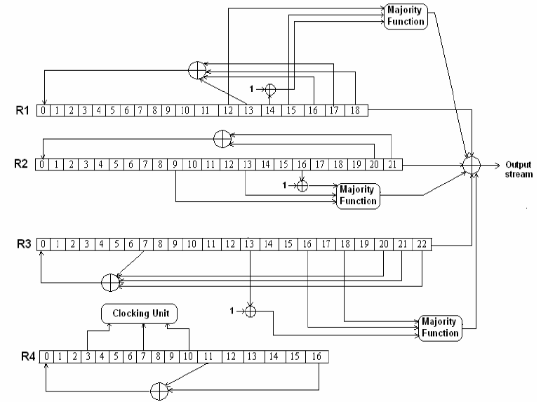
A5/2

Slide 32
Encryption & Authentication

Slide 33
Cryptanalysis of Stream ciphers (Next Week)
There are many known (classical) ways to attack Stream ciphers.
One attack is successful (or brakes) one cipher if it be faster than brute-force attack.
Attacks can be classified based on what type of information attacker accesses or which type information retrieves in attack.
Algebraic attack
Guess and determine attack
Time-memory-data trade off attacks
Distinguishing attack
New attacks are proposed every time for attack new Stream ciphers

Slide 34
time-memory-data tradeoff attacks
A type of attack where an attacker tries to prepare some data in offline phase of attack (table), and attack the cipher in online phase by using available data.
An attacker balances or reduces one or two of those parameters in favor of the other one or two

Slide 35
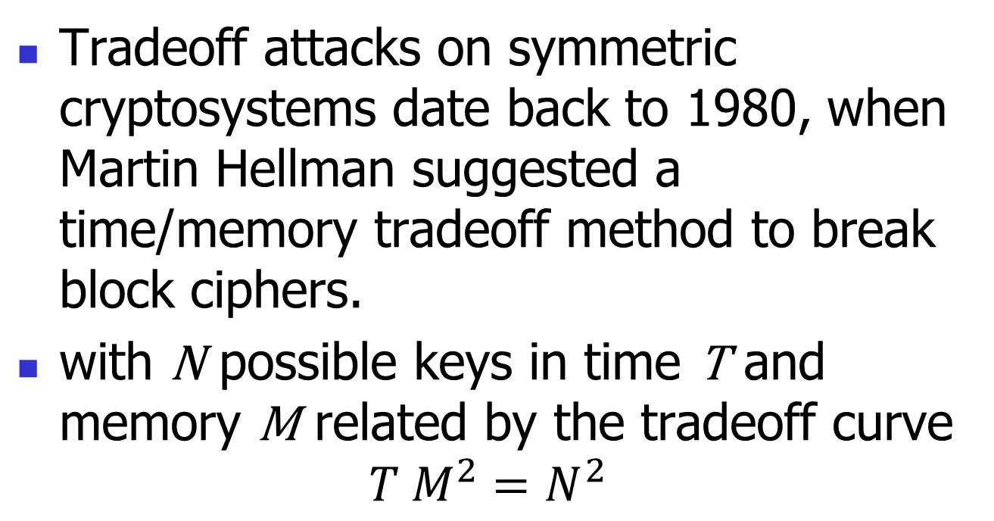
time-memory-data tradeoff attacks
Tradeoff attacks on symmetric cryptosystems date back to 1980, when Martin Hellman suggested a time/memory tradeoff method to break block ciphers.
with N possible keys in time T and memory M related by the tradeoff curve
$${T M}^{2}=N^{2}$$

Slide 36
time-memory-data tradeoff attacks Basics
Pre-computation
One-time work
Results stored in a table
Pre-computation results used to make each subsequent computation faster
Try to balance “memory” and “time”
In general, larger pre-computation requires more initial work and larger “memory” but then each computation takes less “time”

Slide 37
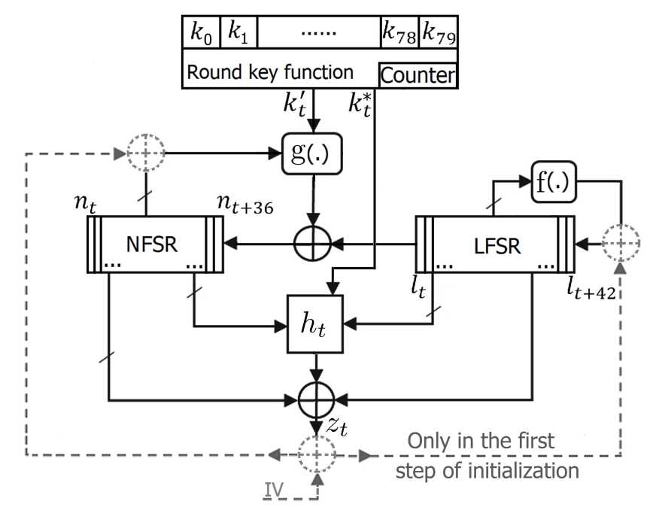
time-memory-data tradeoff attacks
A sorted table of all possible internal state and keystream (offline phase of attack)

Slide 38
time-memory-data tradeoff attacks
One keystream (data) is enough to attack the cipher on online phase of attack.
From internal state, we can retrieve key.
2 keystreams is enough to attack the cipher on online phase of attack if we store half of internal states.
Base on the our available computation (time), memory for storing offline data and known data; attacker make a trade-of between TMD to succeed attack.

Slide 39
time-memory-data tradeoff attacks against small-state stream ciphers
On designing secure small-state stream ciphers against time-memory-data tradeoff attacks.
A new generation of stream ciphers, small-state stream ciphers (SSCs), was born in 2015.
using key bits not only in the initialization but also continuously in the keystream generation phase.

Slide 40
time-memory-data tradeoff attacks
A time-memory-data tradeoff (TMDTO) distinguishing attack was successfully applied against all SSCs in 2017 by Hamann et al. [1].
They suggested using not only key bits but also initial value (IV) bits continuously in the keystream generation phase to strengthen SSCs against TMDTO attacks.

Slide 41
time-memory-data tradeoff attacks
Hamann and Krause proposed a construction based on using only IV bits continuously in packet mode.
They suggested an instantiation of an SSC and claimed that it is resistant to TMDTO attacks.
Accessing IV bits imposes an overhead on cryptosystems that is not acceptable in some applications.

Slide 42
time-memory-data tradeoff attacks
We show that the proposed SSC remains vulnerable to TMDTO attacks.
We propose constructions, based on storing key or IV bits, that are the first to provide full security against TMDTO attacks.
It is possible to obtain parameters for secure SSCs based on these suggested constructions.

Slide 43
time-memory-data tradeoff attacks
Before the introduction of the first SSC (i.e., Sprout), all of the internal states were volatile memory items.
In SSCs, the internal states consist of volatile memory items and also fixed memory items.
The fixed items can be keys, IVs or both, and they continuously participate in the internal state updating and keystream generation.

Slide 44
time-memory-data tradeoff attacks
IV bits are usually produced elsewhere in the system (from some parameters of systems, for example from packet numbers) and transferred to the encryption section.
Accessing IV bits requires extra memory in some cryptosystems.
The construction is unrealistic for some applications, and we show that it cannot provide security against TMDTO attacks

Slide 45
time-memory-data tradeoff attacks
IV Length (IVL)
Continuously used IV (CIV)
Continuously used IV Length (CIVL)
Key Length (KL)
Continuously used Key (CK)
State Length (SL) and Volatile State (VS)
Packet length per IV (PIV)
Packet length per Key (PK) and (PKI)
Notes:
A section of the IV which is used in the initialization and also continuously in the keystream generation phase
A section of the key which is used in the initialization and also continuously in the keystream generation phase
Internal state length in bits
): A section of the internal state which can be changed in every clock (i.e., it is volatile)
The maximum number of keystream bits that can be produced per key/IV pair

Slide 46
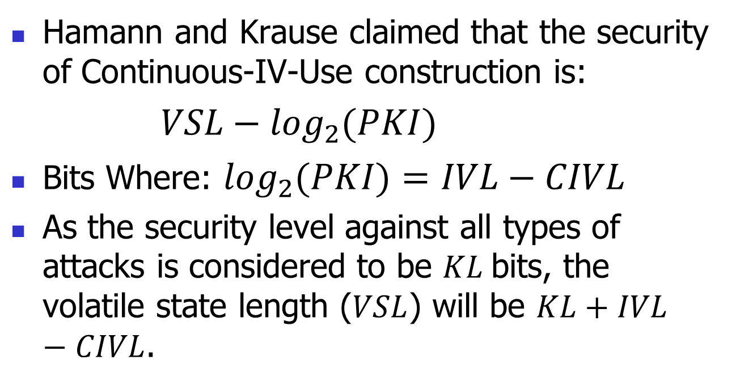
time-memory-data tradeoff attacks
Hamann and Krause claimed that the security of Continuous-IV-Use construction is:
$VSL−\log_{2}{(PKI)}$
Bits Where: $\log_{2}{(PKI)}=IVL−CIVL$
As the security level against all types of attacks is considered to be $KL$bits, the volatile state length ($VSL$) will be $KL+IVL−CIVL$.

Slide 47
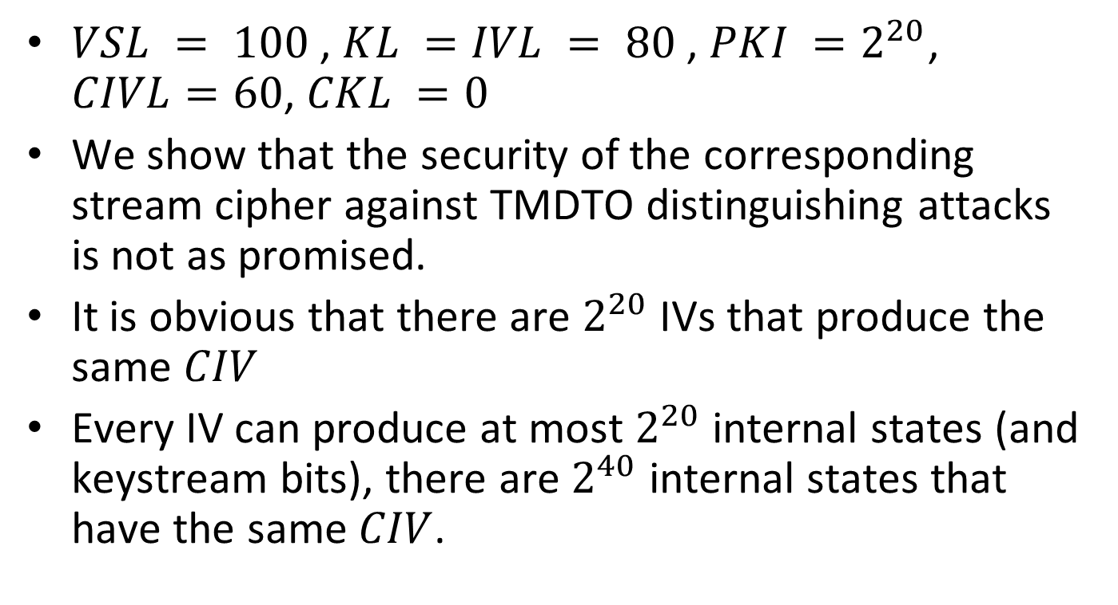
time-memory-data tradeoff attacks
$VSL = 100$, $KL =IVL = 80$, ${PKI =2}^{20}$, $CIVL=60$, $CKL =0$
We show that the security of the corresponding stream cipher against TMDTO distinguishing attacks is not as promised.
It is obvious that there are $2^{20}$ IVs that produce the same $CIV$
Every IV can produce at most $2^{20}$ internal states (and keystream bits), there are $2^{40}$ internal states that have the same $CIV$.

Slide 48
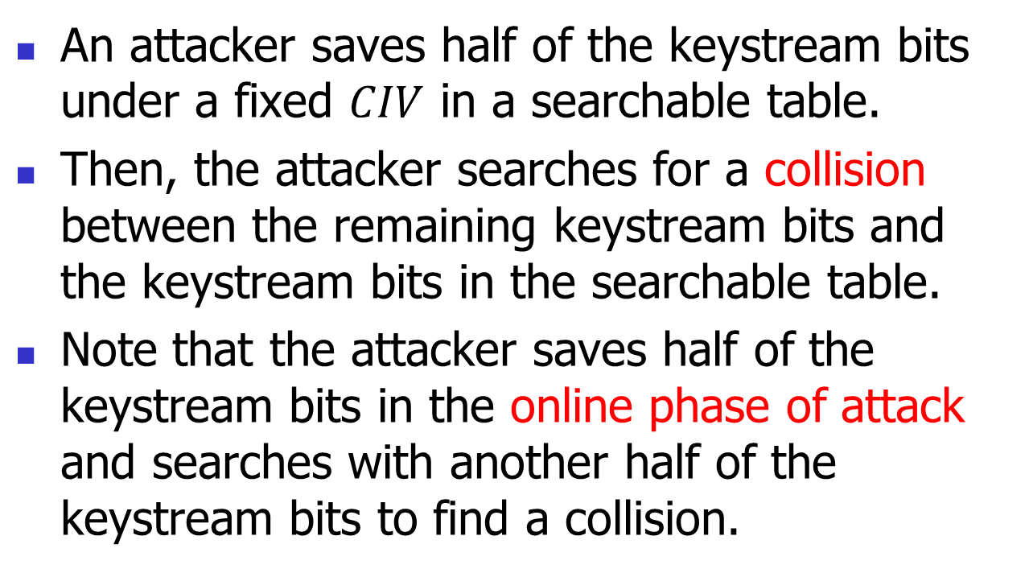
time-memory-data tradeoff attacks
An attacker saves half of the keystream bits under a fixed $CIV$ in a searchable table.
Then, the attacker searches for a collision between the remaining keystream bits and the keystream bits in the searchable table.
Note that the attacker saves half of the keystream bits in the online phase of attack and searches with another half of the keystream bits to find a collision.

Slide 49
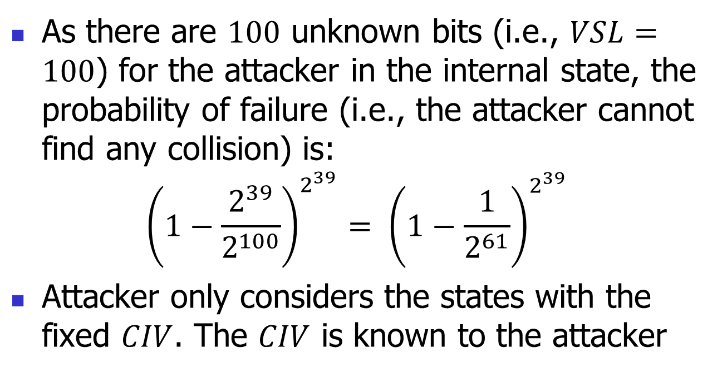
time-memory-data tradeoff attacks
As there are $100$ unknown bits (i.e., $VSL=100$) for the attacker in the internal state, the probability of failure (i.e., the attacker cannot find any collision) is:
$${\left(1−\frac{2^{39}}{2^{100}}\right)}^{2^{39}}= {\left(1−\frac{1}{2^{61}}\right)}^{2^{39}}$$
Attacker only considers the states with the fixed $CIV$. The $CIV$ is known to the attacker

Slide 50
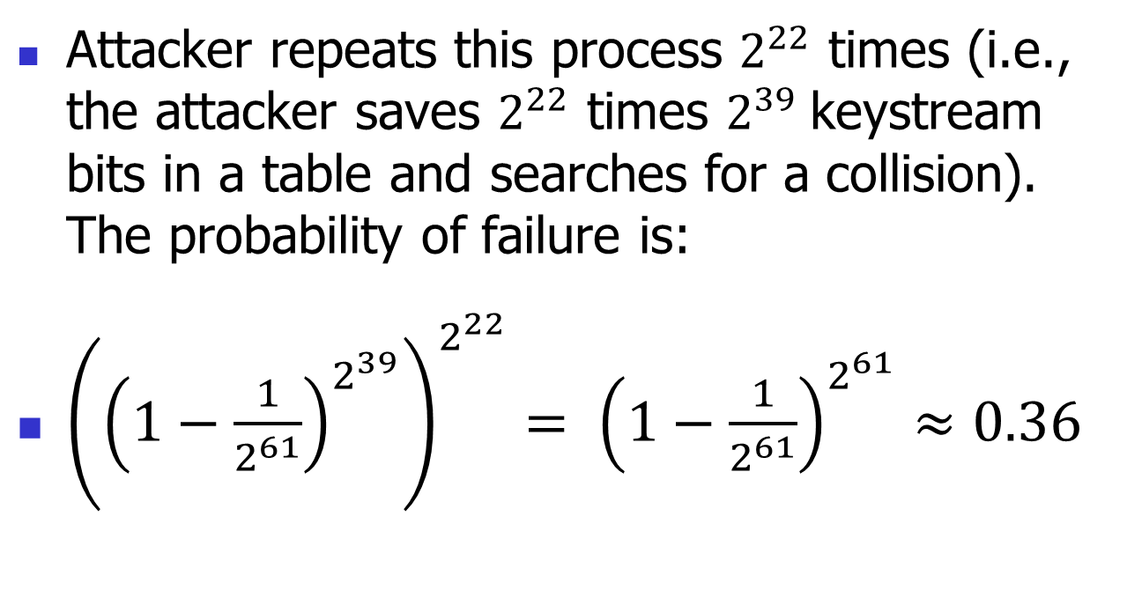
time-memory-data tradeoff attacks
Attacker repeats this process $2^{22}$ times (i.e., the attacker saves $2^{22}$ times $2^{39}$keystream bits in a table and searches for a collision). The probability of failure is:
${\left({\left(1−\frac{1}{2^{61}}\right)}^{2^{39}}\right)}^{2^{22}}= {\left(1−\frac{1}{2^{61}}\right)}^{2^{61}}≈0.36$

Slide 51
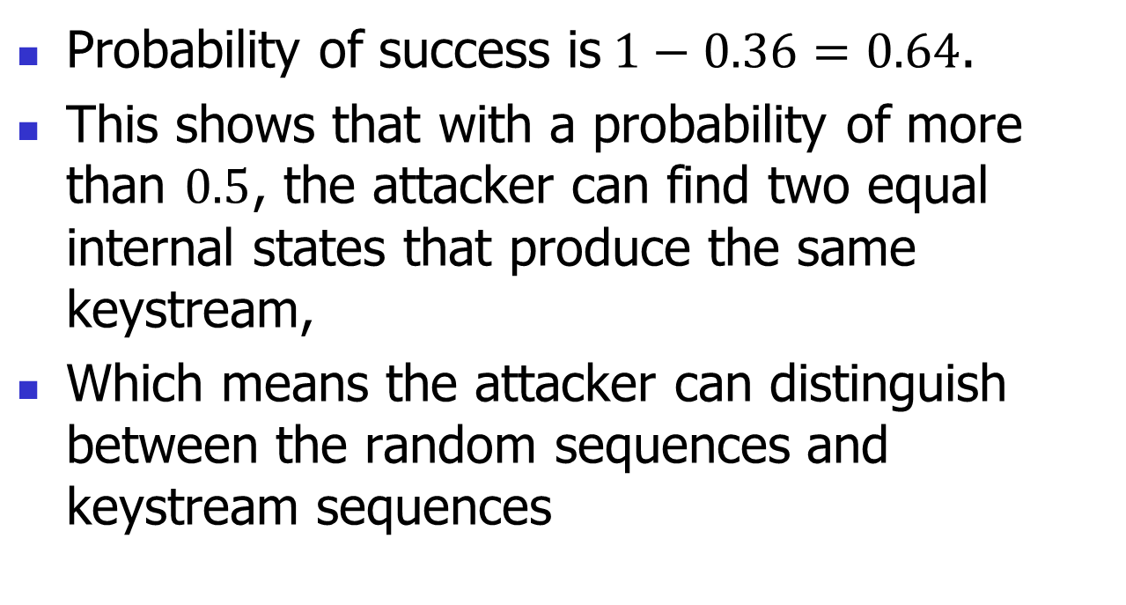
time-memory-data tradeoff attacks
Probability of success is$1−0.36=0.64$.
This shows that with a probability of more than $0.5$, the attacker can find two equal internal states that produce the same keystream,
Which means the attacker can distinguish between the random sequences and keystream sequences

Slide 52
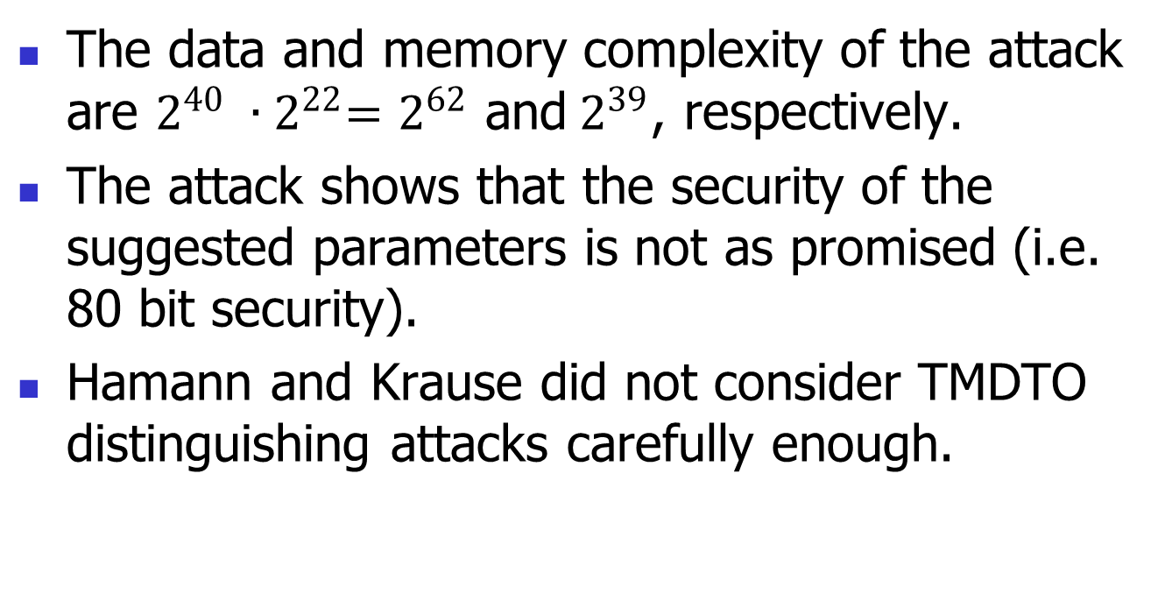
time-memory-data tradeoff attacks
The data and memory complexity of the attack are $2^{40} ∙{ 2}^{22}=2^{62}$ and$2^{39}$, respectively.
The attack shows that the security of the suggested parameters is not as promised (i.e. 80 bit security).
Hamann and Krause did not consider TMDTO distinguishing attacks carefully enough.

Slide 53
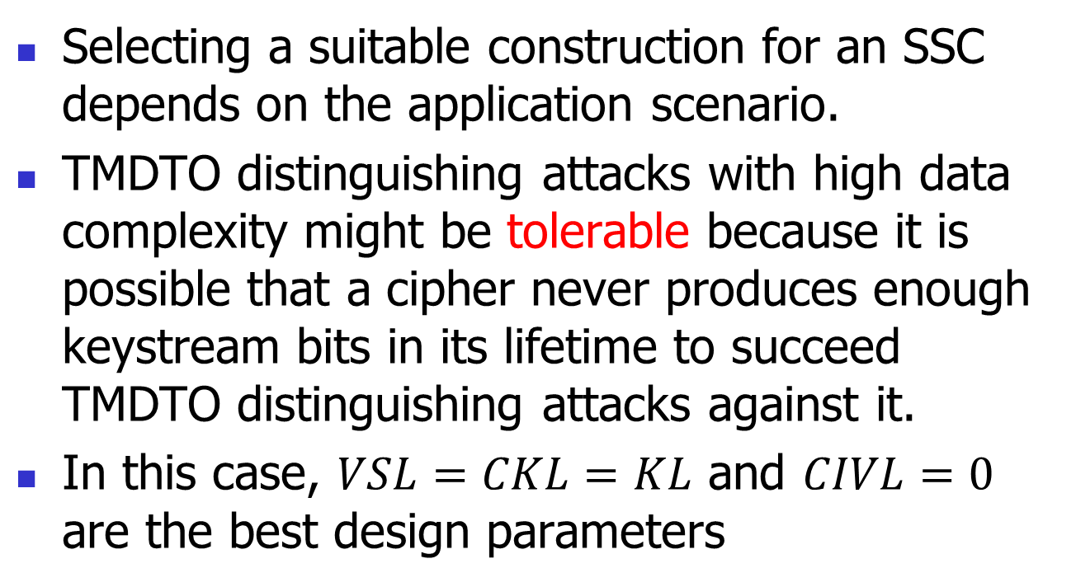
time-memory-data tradeoff attacks
Selecting a suitable construction for an SSC depends on the application scenario.
TMDTO distinguishing attacks with high data complexity might be tolerable because it is possible that a cipher never produces enough keystream bits in its lifetime to succeed TMDTO distinguishing attacks against it.
In this case, $VSL=CKL=KL$ and $CIVL=0$ are the best design parameters

Slide 54
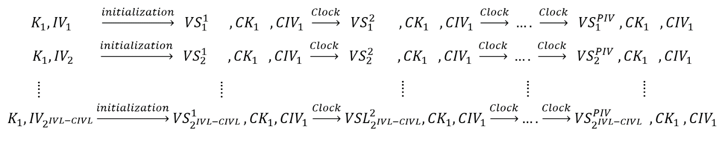
time-memory-data tradeoff attacks
First case: Every IV can be used at most once in the initializations

Slide 55
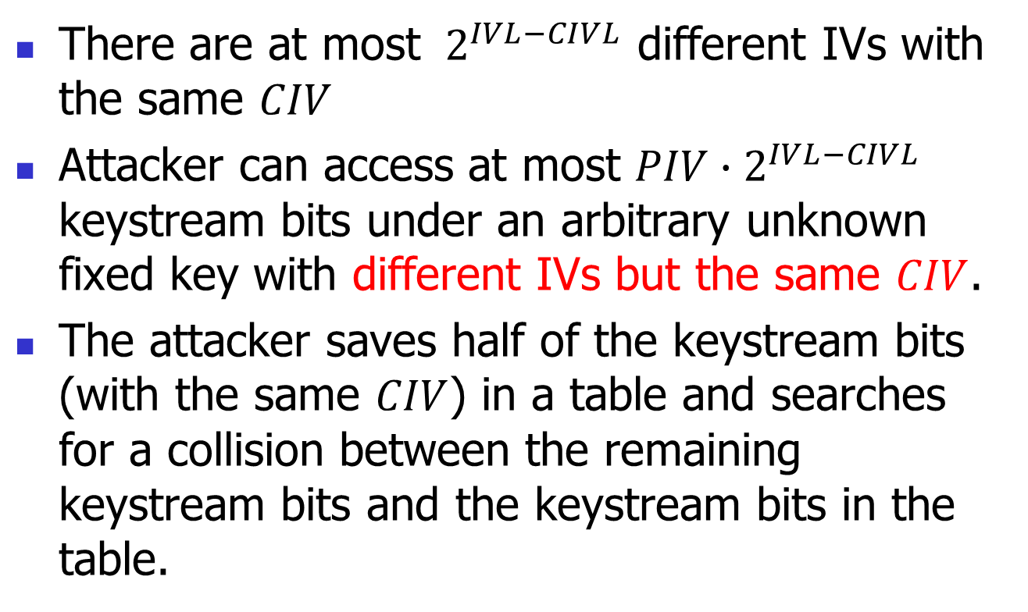
time-memory-data tradeoff attacks
There are at most $2^{IVL−CIVL}$ different IVs with the same $CIV$
Attacker can access at most $PIV{∙2}^{IVL−CIVL}$ keystream bits under an arbitrary unknown fixed key with different IVs but the same $CIV$.
The attacker saves half of the keystream bits (with the same $CIV$) in a table and searches for a collision between the remaining keystream bits and the keystream bits in the table.

Slide 56
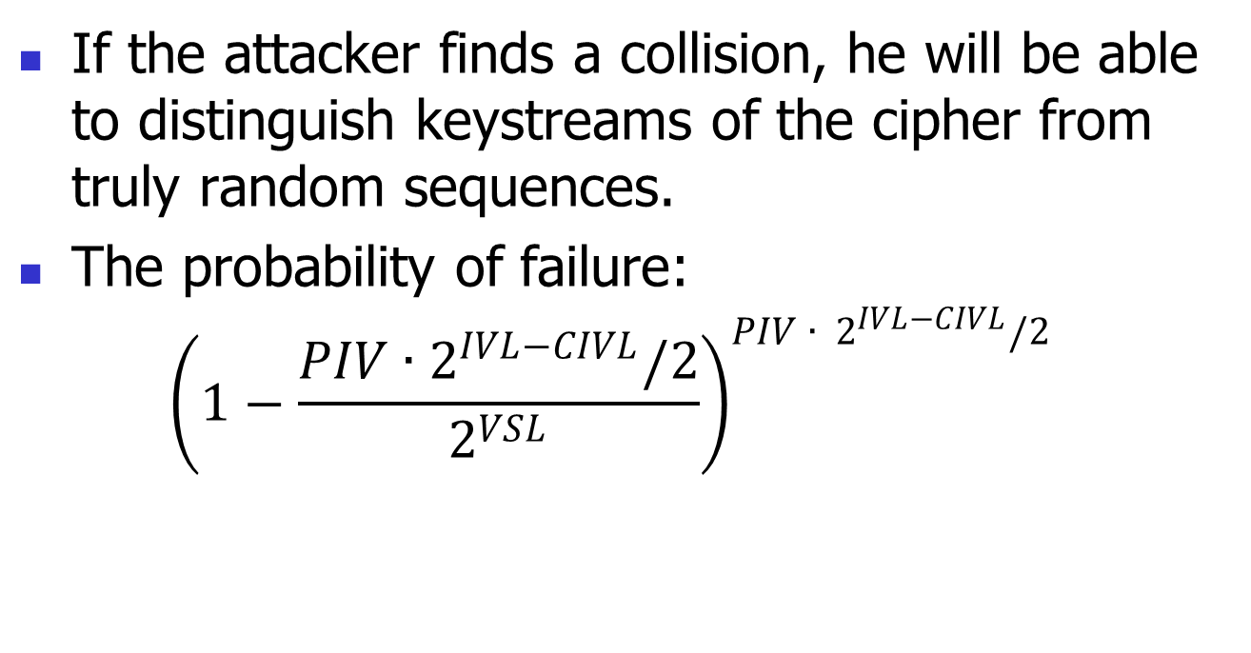
time-memory-data tradeoff attacks
If the attacker finds a collision, he will be able to distinguish keystreams of the cipher from truly random sequences.
The probability of failure:
$${\left(1−\frac{{PIV∙2}^{IVL−CIVL}/2}{2^{VSL}}\right)}^{{PIV ∙ 2}^{IVL−CIVL}/2}$$

Slide 57
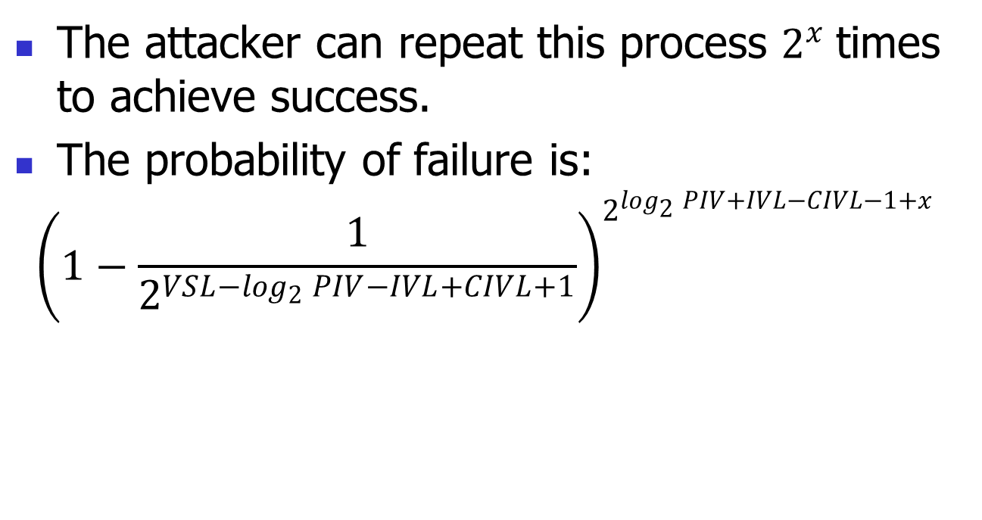
time-memory-data tradeoff attacks
The attacker can repeat this process $2^{x}$times to achieve success.
The probability of failure is:
$${\left(1−\frac{1}{2^{VSL−\log_{2}{PIV−IVL+CIVL+1}}}\right)}^{2^{\log_{2}{PIV}+IVL−CIVL−1+x}}$$

Slide 58
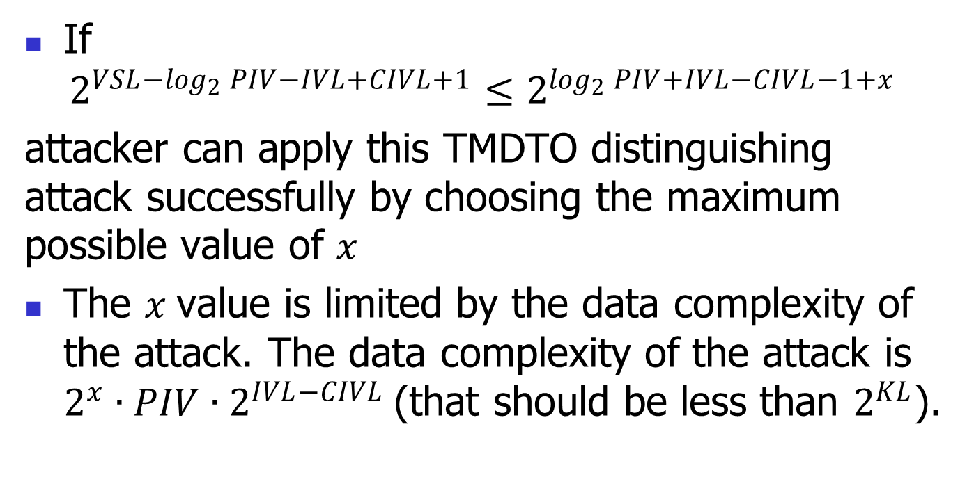
time-memory-data tradeoff attacks
If
$$2^{VSL−\log_{2}{PIV−IVL+CIVL+1}}≤2^{\log_{2}{PIV}+IVL−CIVL−1+x}$$
attacker can apply this TMDTO distinguishing attack successfully by choosing the maximum possible value of $x$
The $x$value is limited by the data complexity of the attack. The data complexity of the attack is $2^{x}∙{PIV∙2}^{IVL−CIVL}$(that should be less than $2^{KL}$).

Slide 59
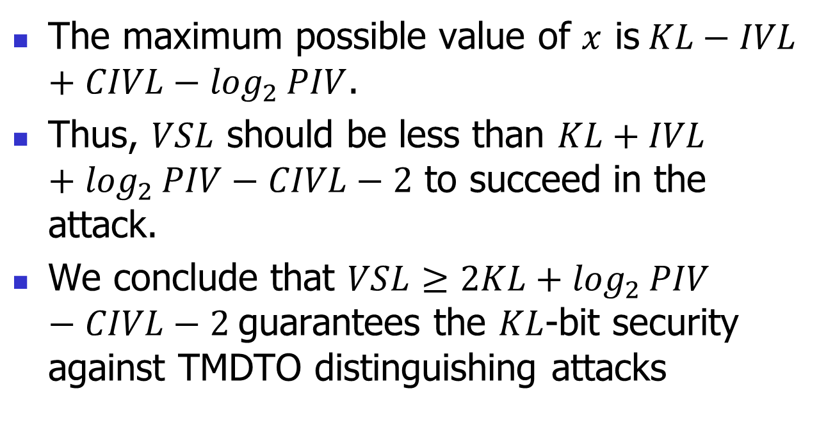
time-memory-data tradeoff attacks
The maximum possible value of $x$ is$KL−IVL+CIVL−\log_{2}{PIV}$.
Thus, $VSL$ should be less than $KL+IVL+\log_{2}{PIV}−CIVL−2$ to succeed in the attack.
We conclude that $VSL≥2KL+\log_{2}{PIV}−CIVL−2$guarantees the $KL$-bit security against TMDTO distinguishing attacks

Slide 60
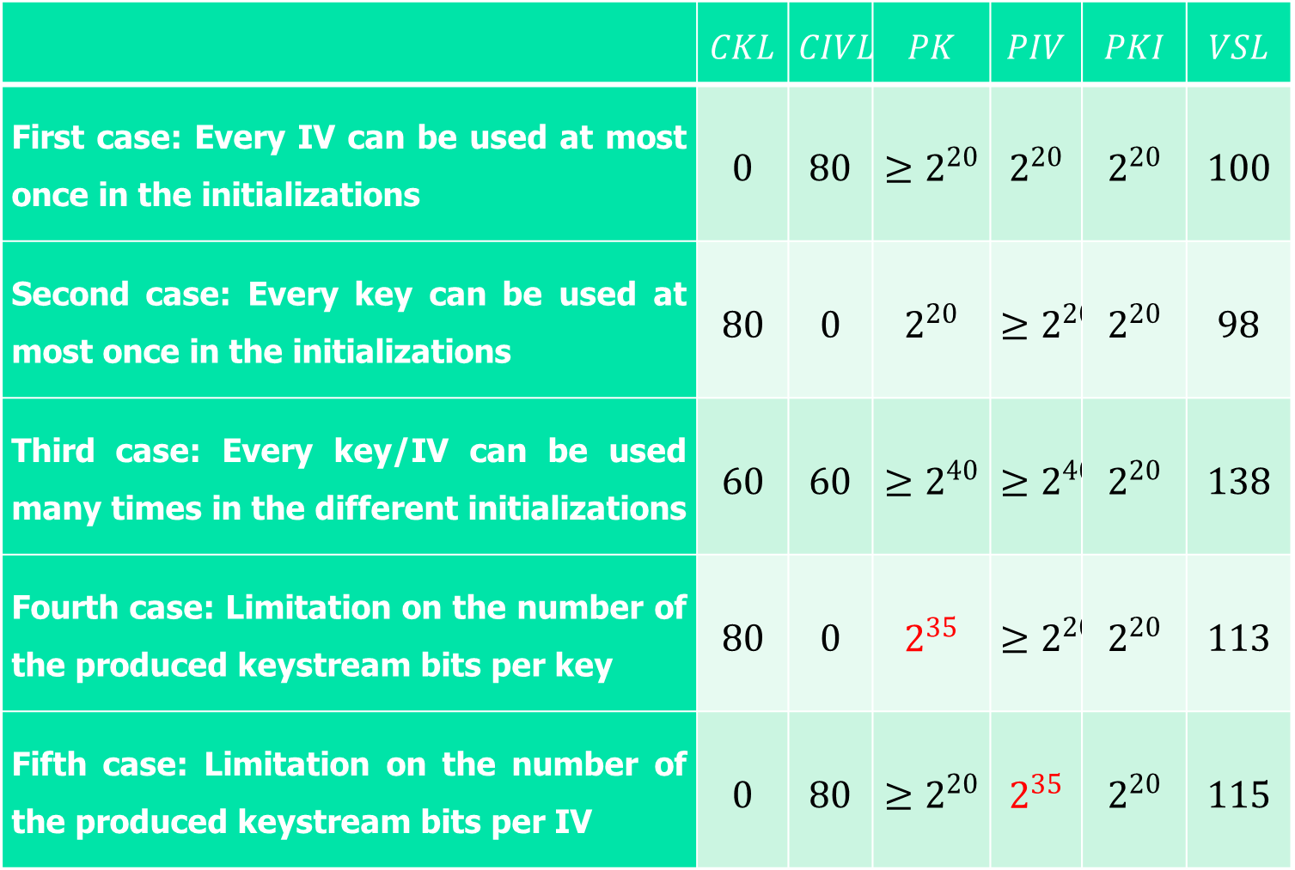
 | $$CKL$$ | $$CIVL$$ | $$PK$$ | $$PIV$$ | $$PKI$$ | $$VSL$$
First case: Every IV can be used at most once in the initializations | $$0$$ | $$80$$ | $$≥2^{20}$$ | $$2^{20}$$ | $$2^{20}$$ | $$100$$
Second case: Every key can be used at most once in the initializations | $$80$$ | $$0$$ | $$2^{20}$$ | $$≥2^{20}$$ | $$2^{20}$$ | $$98$$
Third case: Every key/IV can be used many times in the different initializations | $$60$$ | $$60$$ | $$≥2^{40}$$ | $$≥2^{40}$$ | $$2^{20}$$ | $$138$$
Fourth case: Limitation on the number of the produced keystream bits per key | $$80$$ | $$0$$ | $$2^{35}$$ | $$≥2^{20}$$ | $$2^{20}$$ | $$113$$
Fifth case: Limitation on the number of the produced keystream bits per IV | $$0$$ | $$80$$ | $$≥2^{20}$$ | $$2^{35}$$ | $$2^{20}$$ | $$115$$

Slide 61
Conclusion
We proposed five different constructions based on different applications that can provide full security against TMDTO attacks.
With these constructions, the design of a new generation of stream ciphers (i.e., ultra-lightweight) is achievable with full security against TMDTO attacks.

Slide 62
Thanks
Any question

